Slide 1
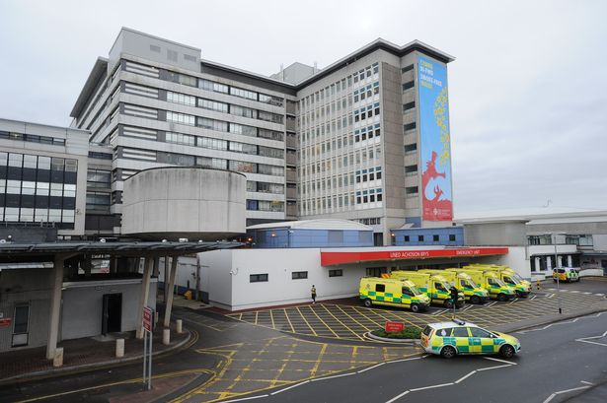
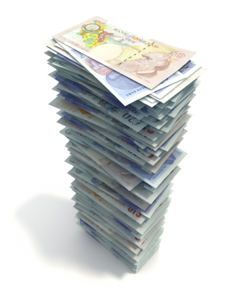
78,000 Patients presenting to GP with new wound diagnosis
700,000
District Nurse Visits
15,000 Patient Admissions
2.3 million prescriptions issued
68,000 Outpatient visits
£330 m
of annual NHS Budget

